Slide 1
Shell Programming - An Eye Opener
- Shriram K Vasudevan

Slide 2
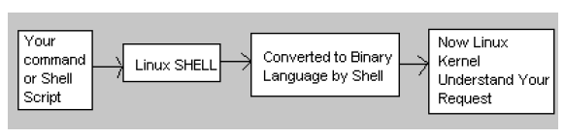
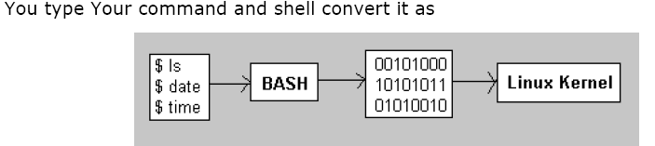
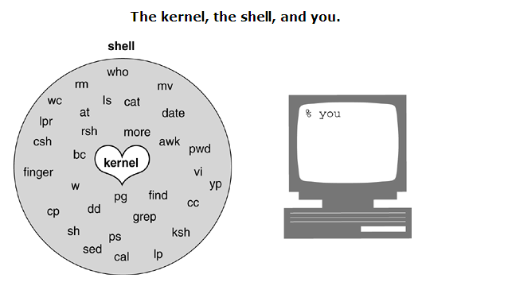
Why do we need Shell??
Computer understand the language of 0's and 1's called binary language.
In early days of computing, instruction are provided using binary language, which is difficult for all of us, to read and write.
So in OS there is special program called Shell. Shell accepts your instruction or commands in English and translate it into computers native binary language.

Slide 3
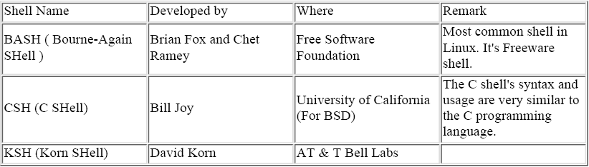
Contd.,
It's environment provided for user interaction.
Shell is an command language interpreter that executes commands read from the standard input device (keyboard) or from a file.
Linux may use one of the following most popular shells (In MS-DOS, Shell name is COMMAND.COM which is also used for same purpose, but it's not as powerful as our Linux Shells are!)

Slide 4
To Find What is your Shell??
$ echo $SHELL
You will now get the shell type that you are using!!
You need to be familiarized with the basic linux/unics commands.
So please be good in that before you jump into Shell Scripting.
Go thro the PPT that I have attached here.. You can get basic understanding of Linux commands.

Slide 5
Know this pl
When you start up your system, the first process called is init.
Each process has a process identification number associated with it, called the PID.
Because init is the first process, its PID is 1.
The init process initializes the system and then starts other processes to open terminal lines and set up the standard input (stdin), standard output (stdout), and standard error (stderr), which are all associated with the terminal.
The standard input normally comes from the keyboard; the standard output and standard error go to the screen. At this point, a login prompt would appear on your terminal.

Slide 6
Know this
After you type your login name, you will be prompted for a password.
The /bin/login program then verifies your identity by checking the first field in the passwd file.
If your username is there, the next step is to run the password you typed through an encryption program to determine if it is indeed the correct password.
Once your password is verified, the login program sets up an initial environment consisting of variables that define the working environment that will be passed on to the shell.
Init
Type Login Name
You will be prompted for password. Your identity will be checked.
If passwd is right, The environment is set up

Slide 7
Know this
The HOME, SHELL, USER, and LOGNAME variables are assigned values extracted from information in the passwd file.
The HOME variable is assigned your home directory, and the SHELL variable is assigned the name of the login shell, which is the last entry in the passwd file.
The USER and/or LOGNAME variables are assigned your login name.
A search path variable is set so that commonly used utilities may be found in specified directories.
When login has finished, it will execute the program found in the last entry of the passwd file.
Normally, this program is a shell.
If the last entry in the passwd file is /bin/csh, the C shell program is executed.
If the last entry in the passwd file is /bin/bash or is null, the Bash shell starts up.
If the last entry is /bin/ksh or /bin/pdksh, the Korn shell is executed. This shell is called the login shell.

Slide 8
Responsibilities of Shell
The shell is ultimately responsible for making sure that any commands typed at the prompt get executed properly. Included in those responsibilities are:
Reading input and parsing the command line
Evaluating special characters, such as wildcards and the history character
Setting up pipes, redirection, and background processing
Handling signals
Setting up programs for execution

Slide 9
Some Syntaxes now for you to proceed further - Variables in Linux
Sometimes to process our data/information, it must be kept in computers RAM memory.
RAM memory is divided into small locations, and each location had unique number called memory location/address, which is used to hold our data.
Programmer can give a unique name to this memory location/address called memory variable or variable (Its a named storage location that may take different values, but only one at a time).
In Linux, there are two types of variable
1) System variables - Created and maintained by Linux itself. This type of variable defined in CAPITAL LETTERS.
2) User defined variables (UDV) - Created and maintained by user. This type of variable defined in lower LETTERS.

Slide 10
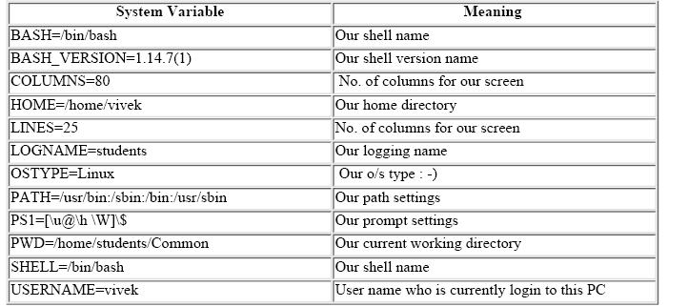
Some system variables
You can see system variables by giving command like $ set, Some of the important System variables are
NOTE that Some of the above settings can be different in your PC. You can print any of the above
variables contain as follows
$ echo $USERNAME
$ echo $HOME
Caution: Do not modify System variable this can some time create problems

Slide 11
Some syntax
Syntax: variablename=value
NOTE: Here 'value' is assigned to given 'variablename' and Value must be on right side = sign For
e.g.
$ no=10 # this is ok
$ 10=no # Error, NOT Ok, Value must be on right side of = sign.
To define variable called 'vech' having value Bus
$ vech=Bus
To define variable called n having value 10
$ n=10
Rules for Naming variable name (Both UDV and System Variable)
(1) Variable name must begin with Alphanumeric character or underscore character (_), followed by one or more Alphanumeric character.
For e.g. Valid shell variable are as follows
HOME
SYSTEM_VERSION
vech
no
(2) Don't put spaces on either side of the equal sign when assigning value to variable. For e.g.. In following variable declaration there will be no error
$ no=10
But here there will be problem for following
$ no =10
$ no= 10
$ no = 10

Slide 12
Some syntax – contd.,
3) Variables are case-sensitive, just like filename in Linux. For e.g.
$ no=10
$ No=11
$ NO=20
$ nO=2
Above all are different variable name, so to print value 20 we have to use
$ echo $NO and Not any
of the following
$ echo $no # will print 10 but not 20
$ echo $No # will print 11 but not 20
$ echo $nO # will print 2 but not 20
(4) You can define NULL variable as follows (NULL variable is variable which has no value at the time
of definition) For e.g.
$ vech=
$ vech=""
Try to print it's value $ echo $vech , Here nothing will be shown because variable has no value i.e. NULL variable.
(5) Do not use ?,* etc, to name your variable names.

Slide 13
GETTING INTO MATHS
How to print sum of two numbers, let's say 6 and 3
$ echo 6 + 3
This will print 6 + 3, not the sum 9, To do sum or math operations in shell use expr, syntax is as follows
Syntax: expr op1 operator op2
Where, op1 and op2 are any Integer Number (Number without decimal point) and operator can be
+ Addition
- Subtraction
/ Division
% Modular, to find remainder For e.g. 20 / 3 = 6 , to find remainder 20 % 3 = 2, (Remember its integer calculation)
\* Multiplication
$ expr 6 + 3
Now It will print sum as 9 , But
$ expr 6+3
will not work because space is required between number and operator

Slide 14
GETTING INTO MATHS
How to define two variable x=20, y=5 and then to print division of x and y (i.e. x/y)
$x=20
$ y=5
$ expr x / y
Modify above and store division of x and y to variable called z
$ x=20
$ y=5
$ z=`expr x / y`
$ echo $z

Slide 15
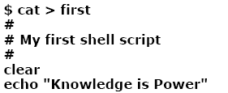
Let us write the first shell script!!
$ ./first
This will give error since we have not set Execute permission for our script first; to do this type command
$ chmod +x first (or)
$ chmod 777 first
$ ./first
This will get you the output

Slide 16
Let me add a quote
QUOTES
There are few types of quotes
$ echo "Today is date"
Can't print message with today's date.
$ echo "Today is `date`”
Now it will print today's date as, Today is Tue Jan ....,See the `date` statement uses back quote,
$ expr 1 + 3
$ expr 2 - 1
$ expr 10 / 2
$ expr 20 % 3 # remainder read as 20 mod 3 and remainder is 2)
$ expr 10 \* 3 # Multiplication use \* not * since its wild card)
$ echo `expr 6 + 3`
For the last statement not the following points
1) First, before expr keyword we used ` (back quote) sign not the (single quote i.e. ') sign. Back
quote is generally found on the key under tilde (~) on PC keyboards OR To the above of TAB key.
2) Second, expr is also end with ` i.e. back quote.
3) Here expr 6 + 3 is evaluated to 9, then echo command prints 9 as sum
4) Here if you use double quote or single quote, it will NOT work, For eg.
$ echo "expr 6 + 3" # It will print expr 6 + 3
$ echo 'expr 6 + 3'

Slide 17
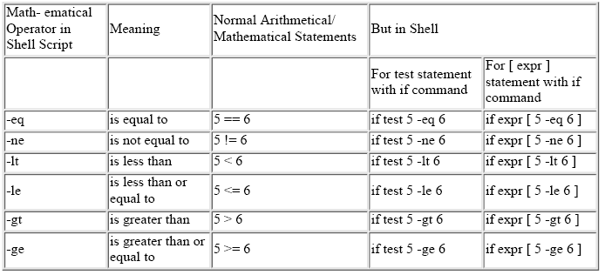
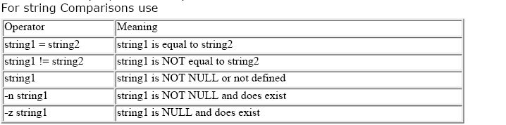
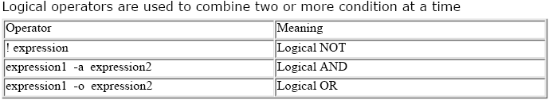
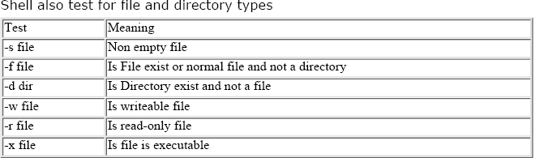
Few Syntaxes

Slide 18
For a While please listen!!
while loop
Syntax:
while [ condition ]
do
command1
command2
command3
..
....
done
Loop is executed as long as given condition is true.
E.g.
while [ $num –ge 1]
For Loop
for { variable name } in { list }
do
execute one for each item in the list until the list is not finished (And repeat all statement between do and done)
done
$ cat > testfor
for i in 1 2 3 4 5
do
echo "Welcome $i times“
done
Run it as,
$ chmod +x testfor
$ ./testfor
Also u can use for ((i=0;i<10;1++)

Slide 19
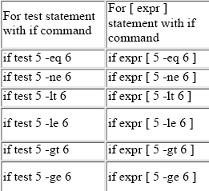
Few more syntaxes!!
Syntax
if condition
then
command1 if condition is true or if exit status
of condition is 0(zero)
...
...
else
command2 if condition is false or if exit status
of condition is >0 (nonzero)
...
...
fi
test command or [ expr ]
test command or [ expr ] is used to see if an expression is true, and if it is true it return zero(0), otherwise returns nonzero(>0) for false.

Slide 20
Example Programs and Exercises

Slide 21
Thank you all
- Shriram K Vasudevan

